Slide 1
ECE 313: PROBABILITY WITH ENGINEERING APPLICATIONS
Fall 2023
Prof. Eric Chitambar
Lecture 28

Slide 2




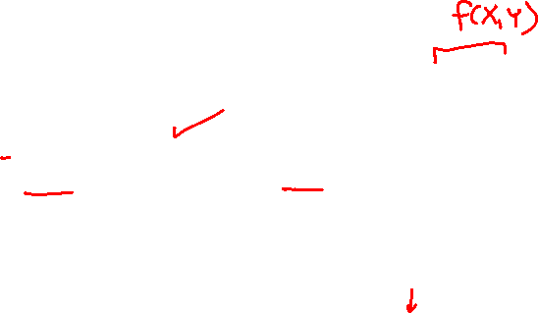
Sum of Random Variables

Slide 3
Sum of Random Variables

Slide 4





Sum of Random Variables

Slide 5
Sum of Random Variables

Slide 6

Jointly Distributed Random Variables

Slide 7
Jointly Distributed Random Variables

Slide 8

Jointly Distributed Random Variables

Slide 9

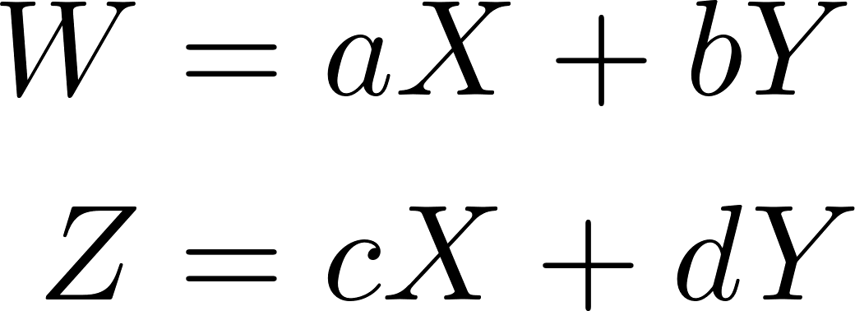


Linear Transformation of Joint R.V.s

Slide 10

Linear Transformation of Joint R.V.s

